Slide 1







CRUISING THROUGH TOWN
Optimising Your Journey for a Satisfyingly Speedier Commute
Austen Wallis

Slide 2
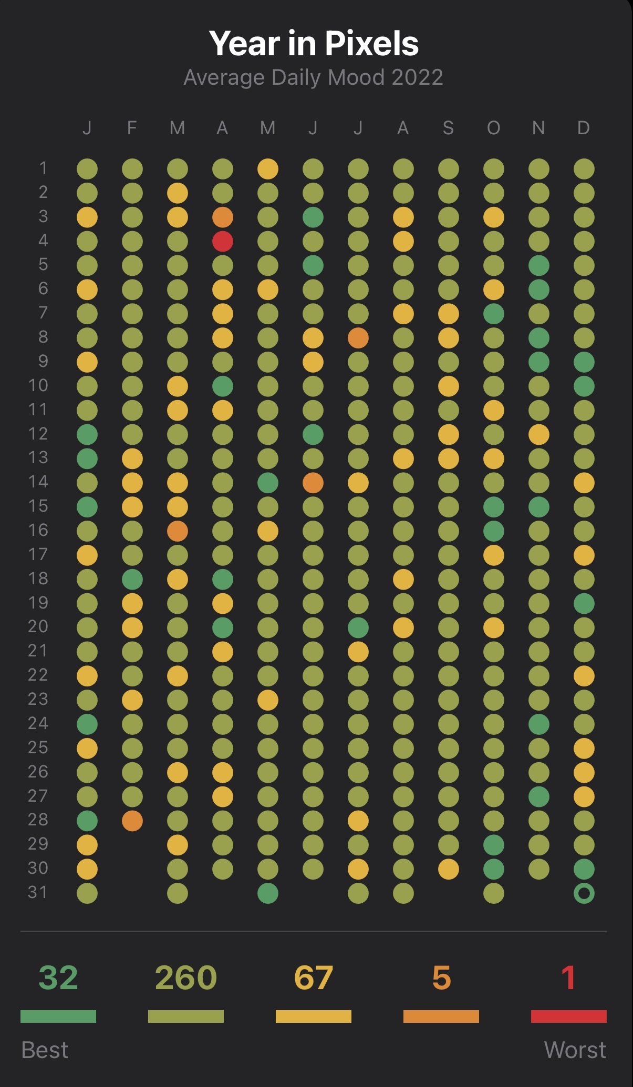
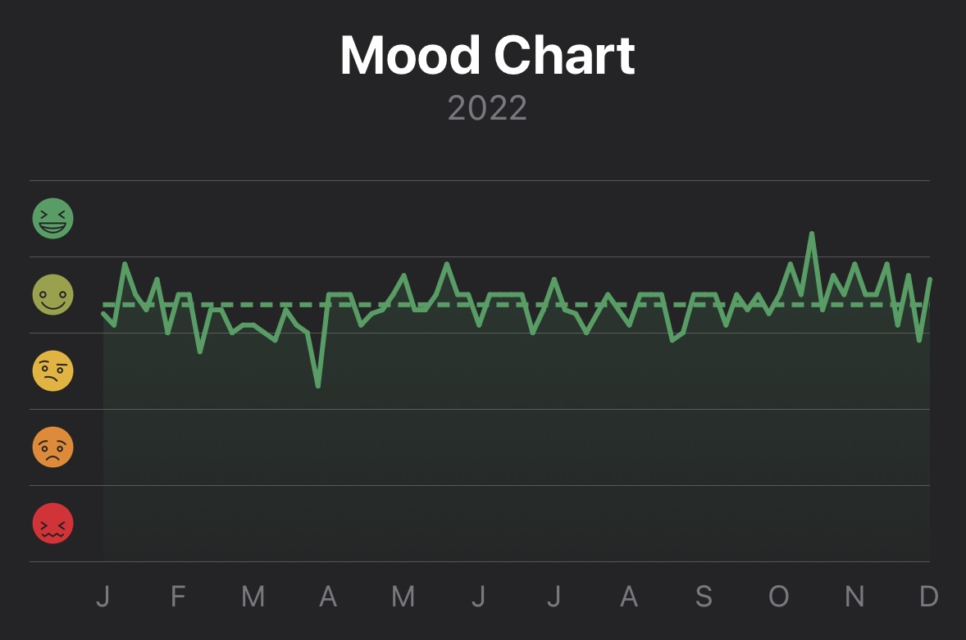
My Mood Profile

Slide 3
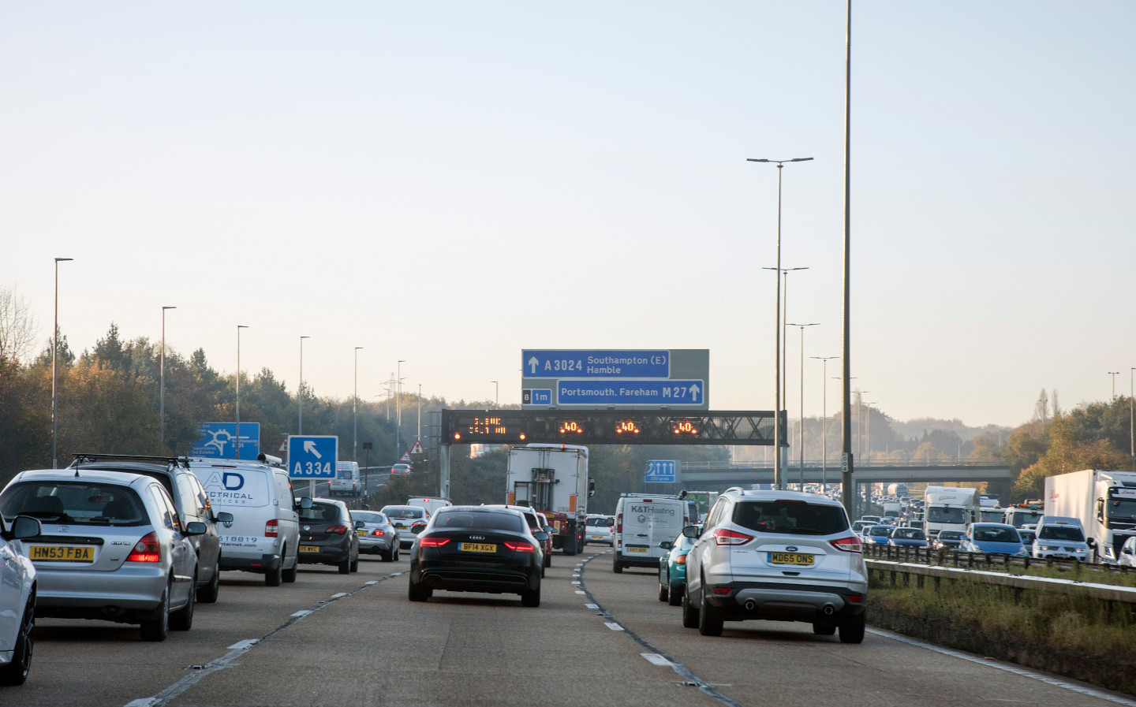

Slide 4
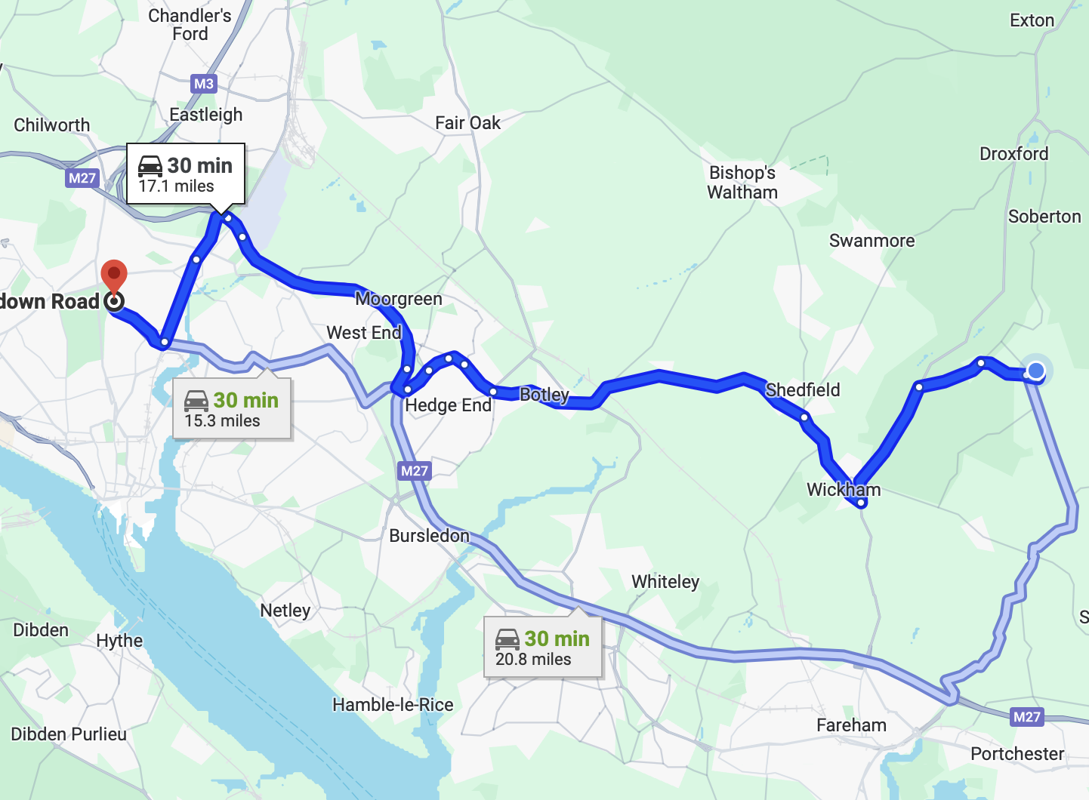
Problems to Solve
My Commute
(1) - I need to park near Campus before 8:10am

Slide 5
Problems to Solve
(2) - I need to wake up as late as physically possible.
(3) - I want to minimise the time I spend in traffic.
Can we work out the best time to leave?

Slide 6




90 day free trial
~£235 free credit
Released March 2023
+
=

Slide 7
Python Using the Routes API
API works by sending a HTTP POST request.
The request needs to included:
The URL of our REST request.
Header information such as our API key and desired outputs
The route and additional options in the JSON request body

Slide 8
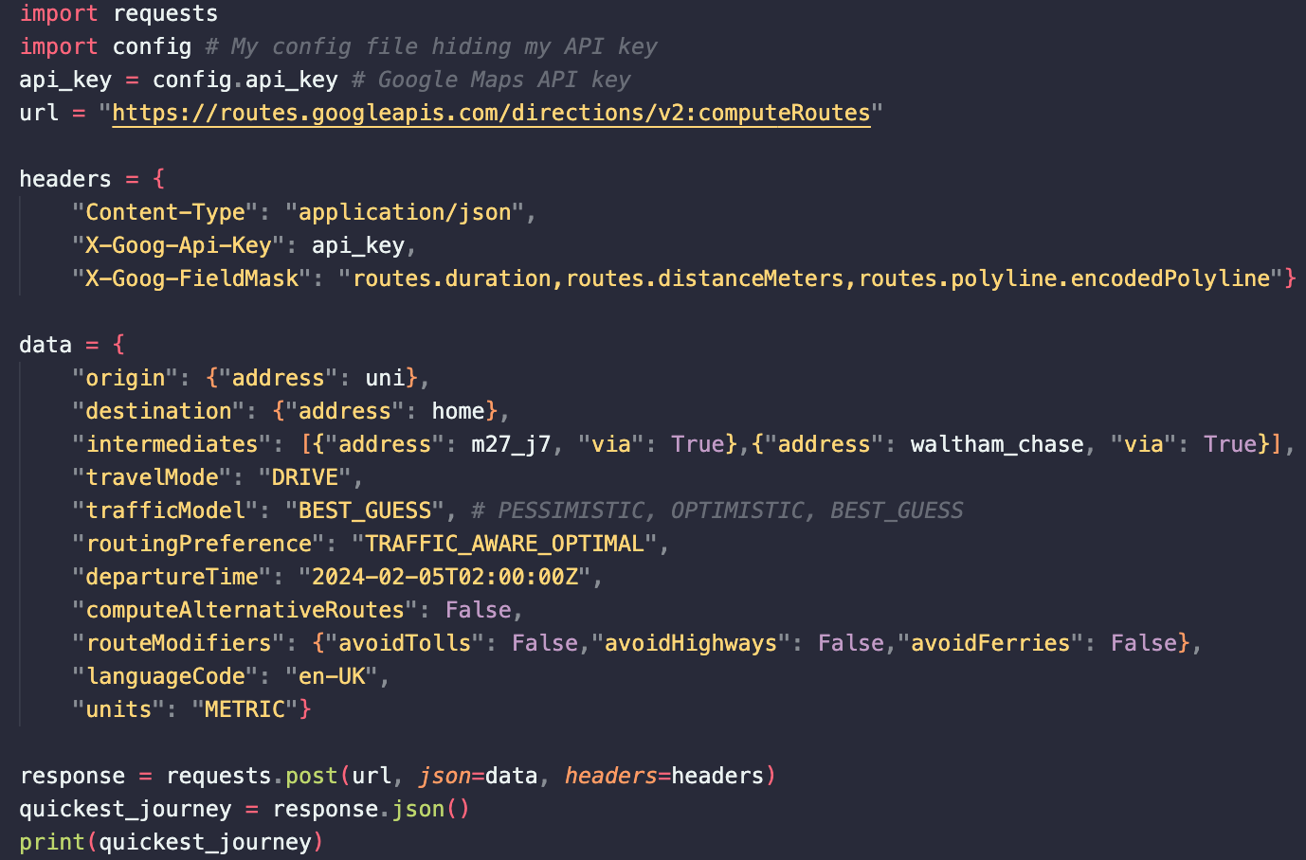


Slide 9
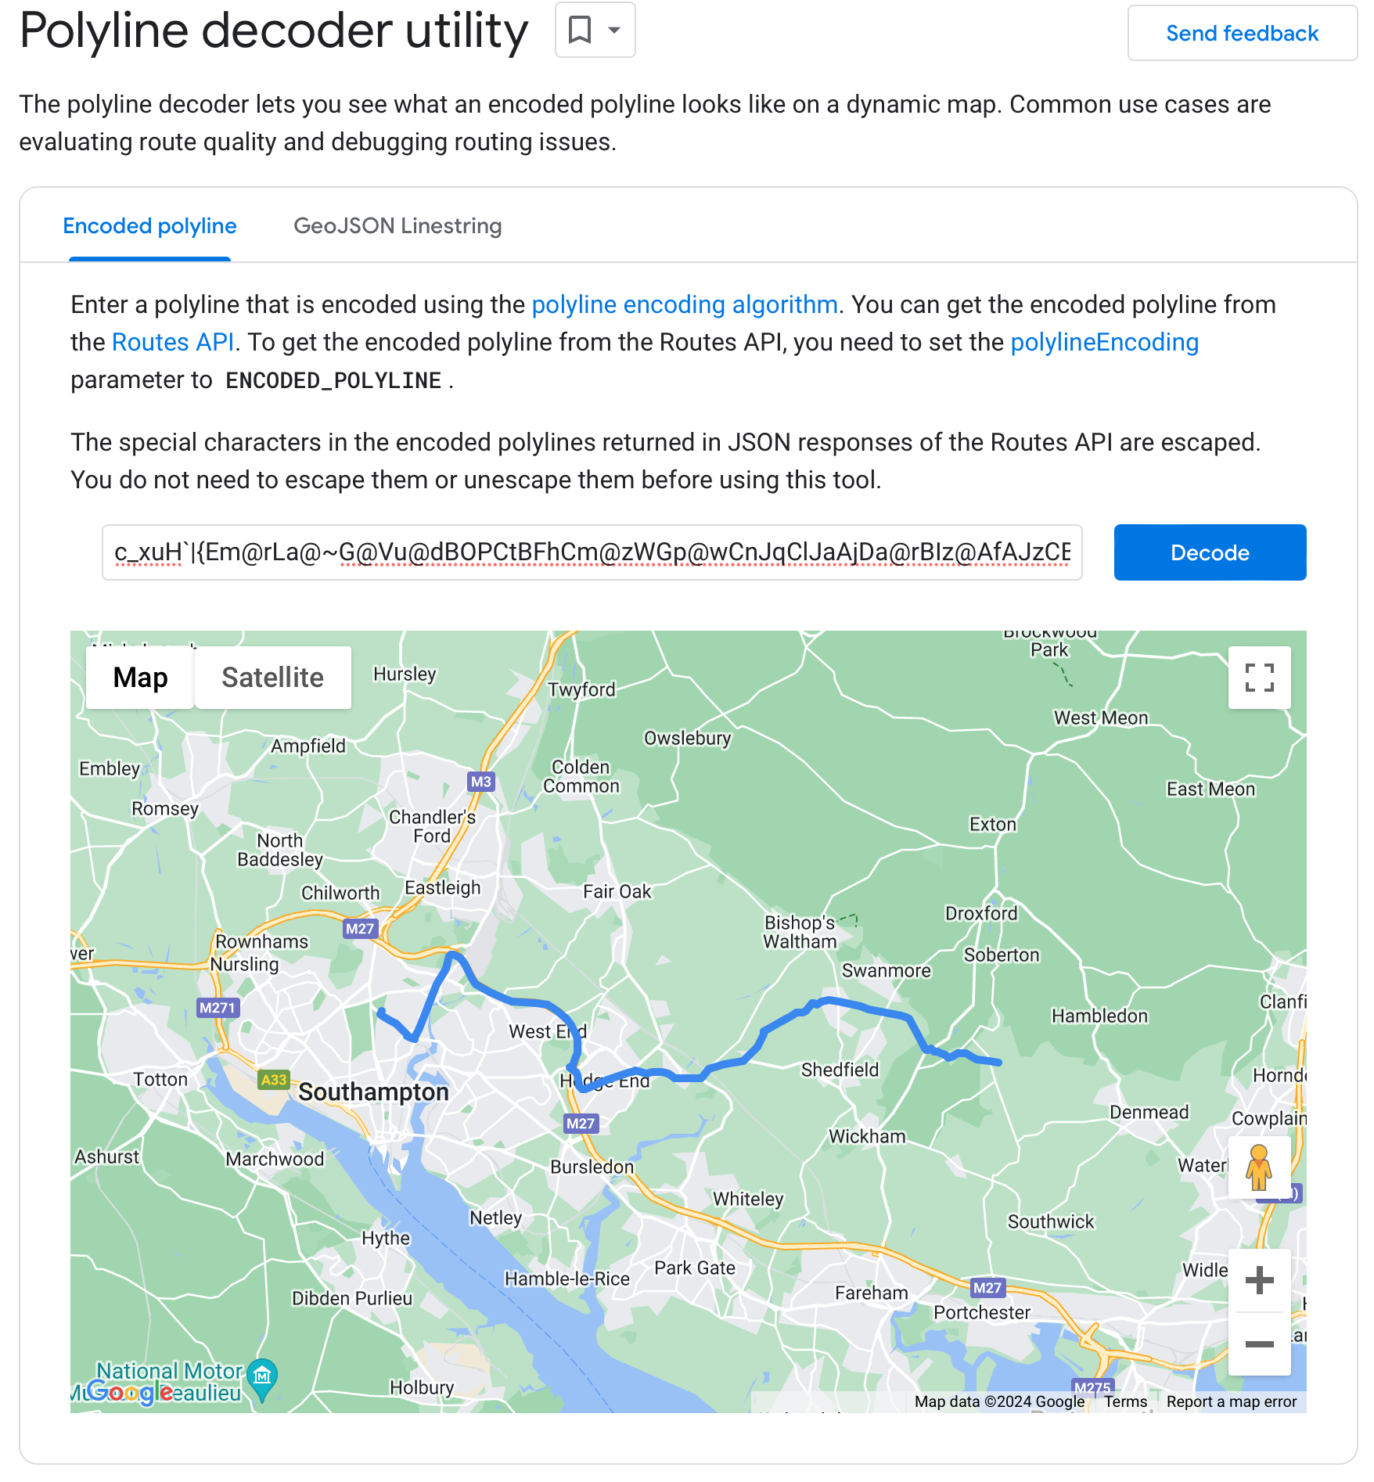

Output
Returns a dictionary

Slide 10
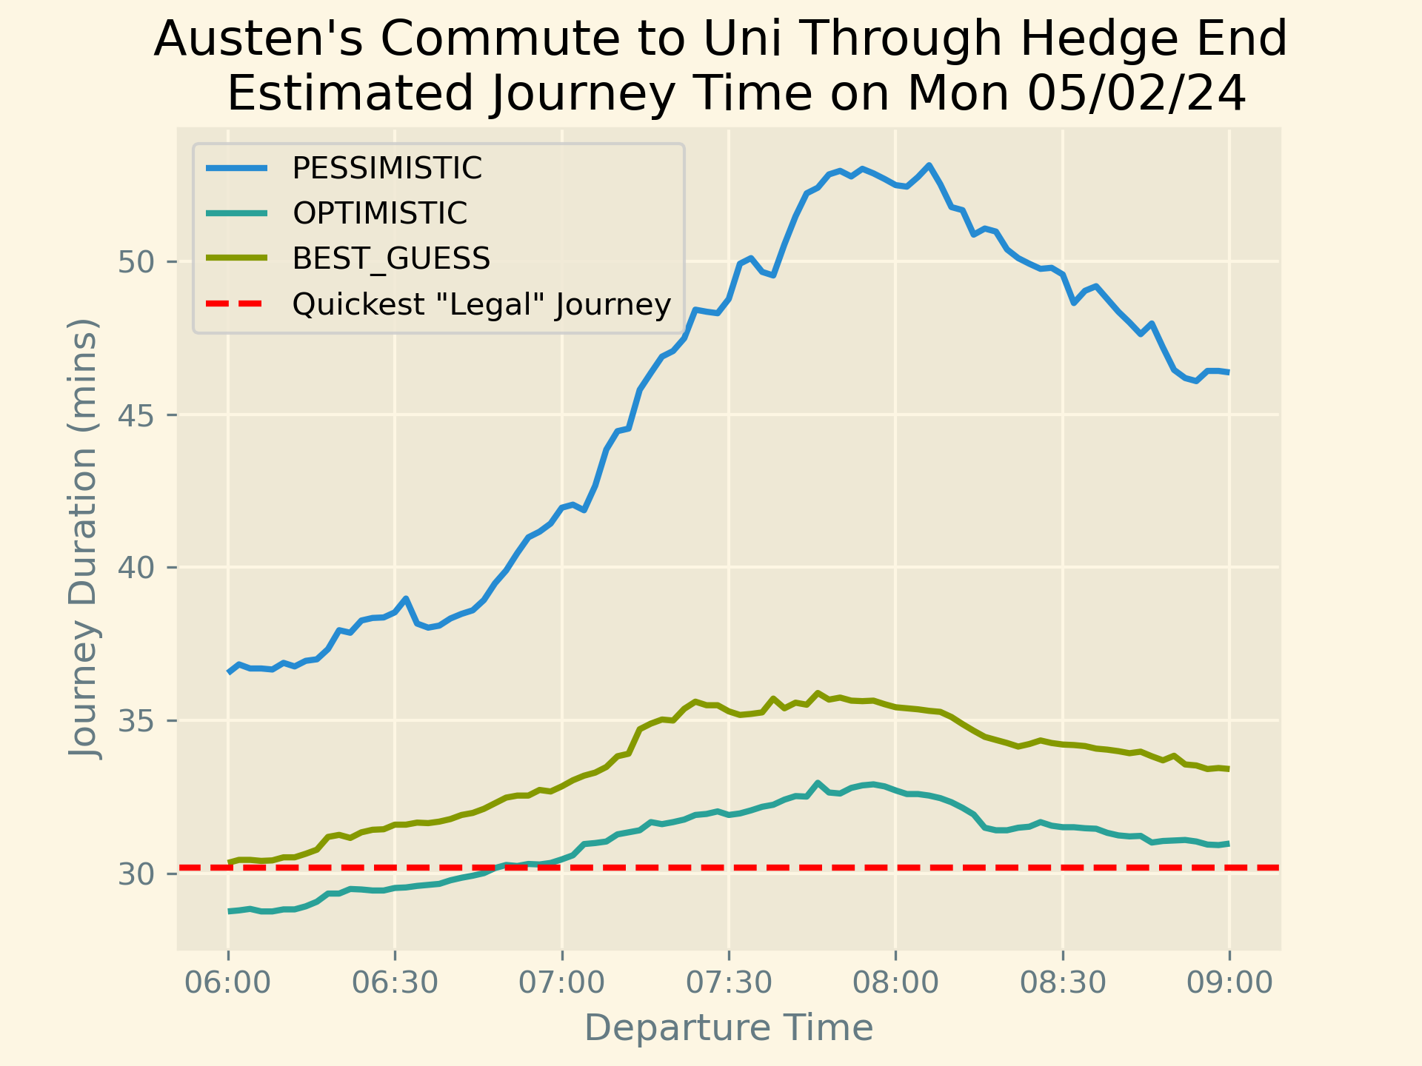
Results
Day of Week To Uni | Pessimistic Leave By | Best Guess Leave By
Monday | 07:24 | 07:36
Tuesday | 07:16 | 07:32
Wednesday | 07:16 | 07:36
Thursday | 07:22 | 07:38
Friday | 07:24 | 07:38

Slide 11
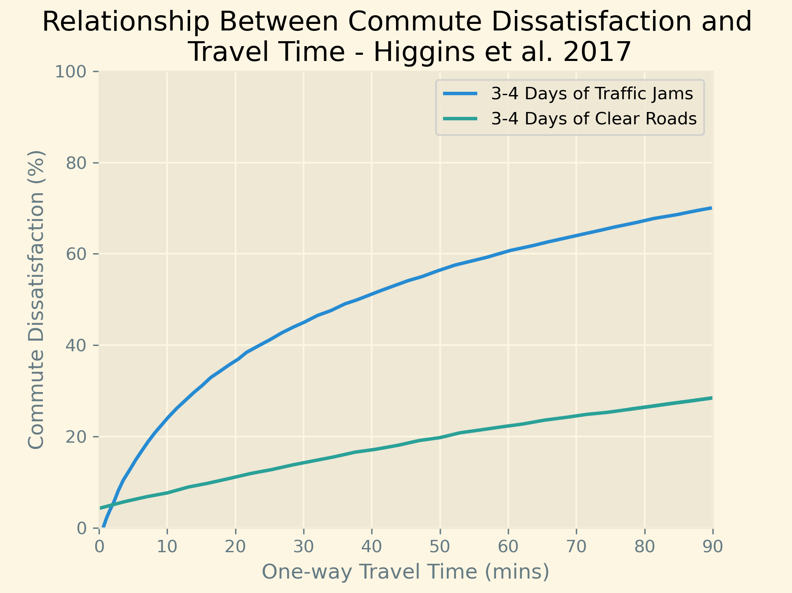
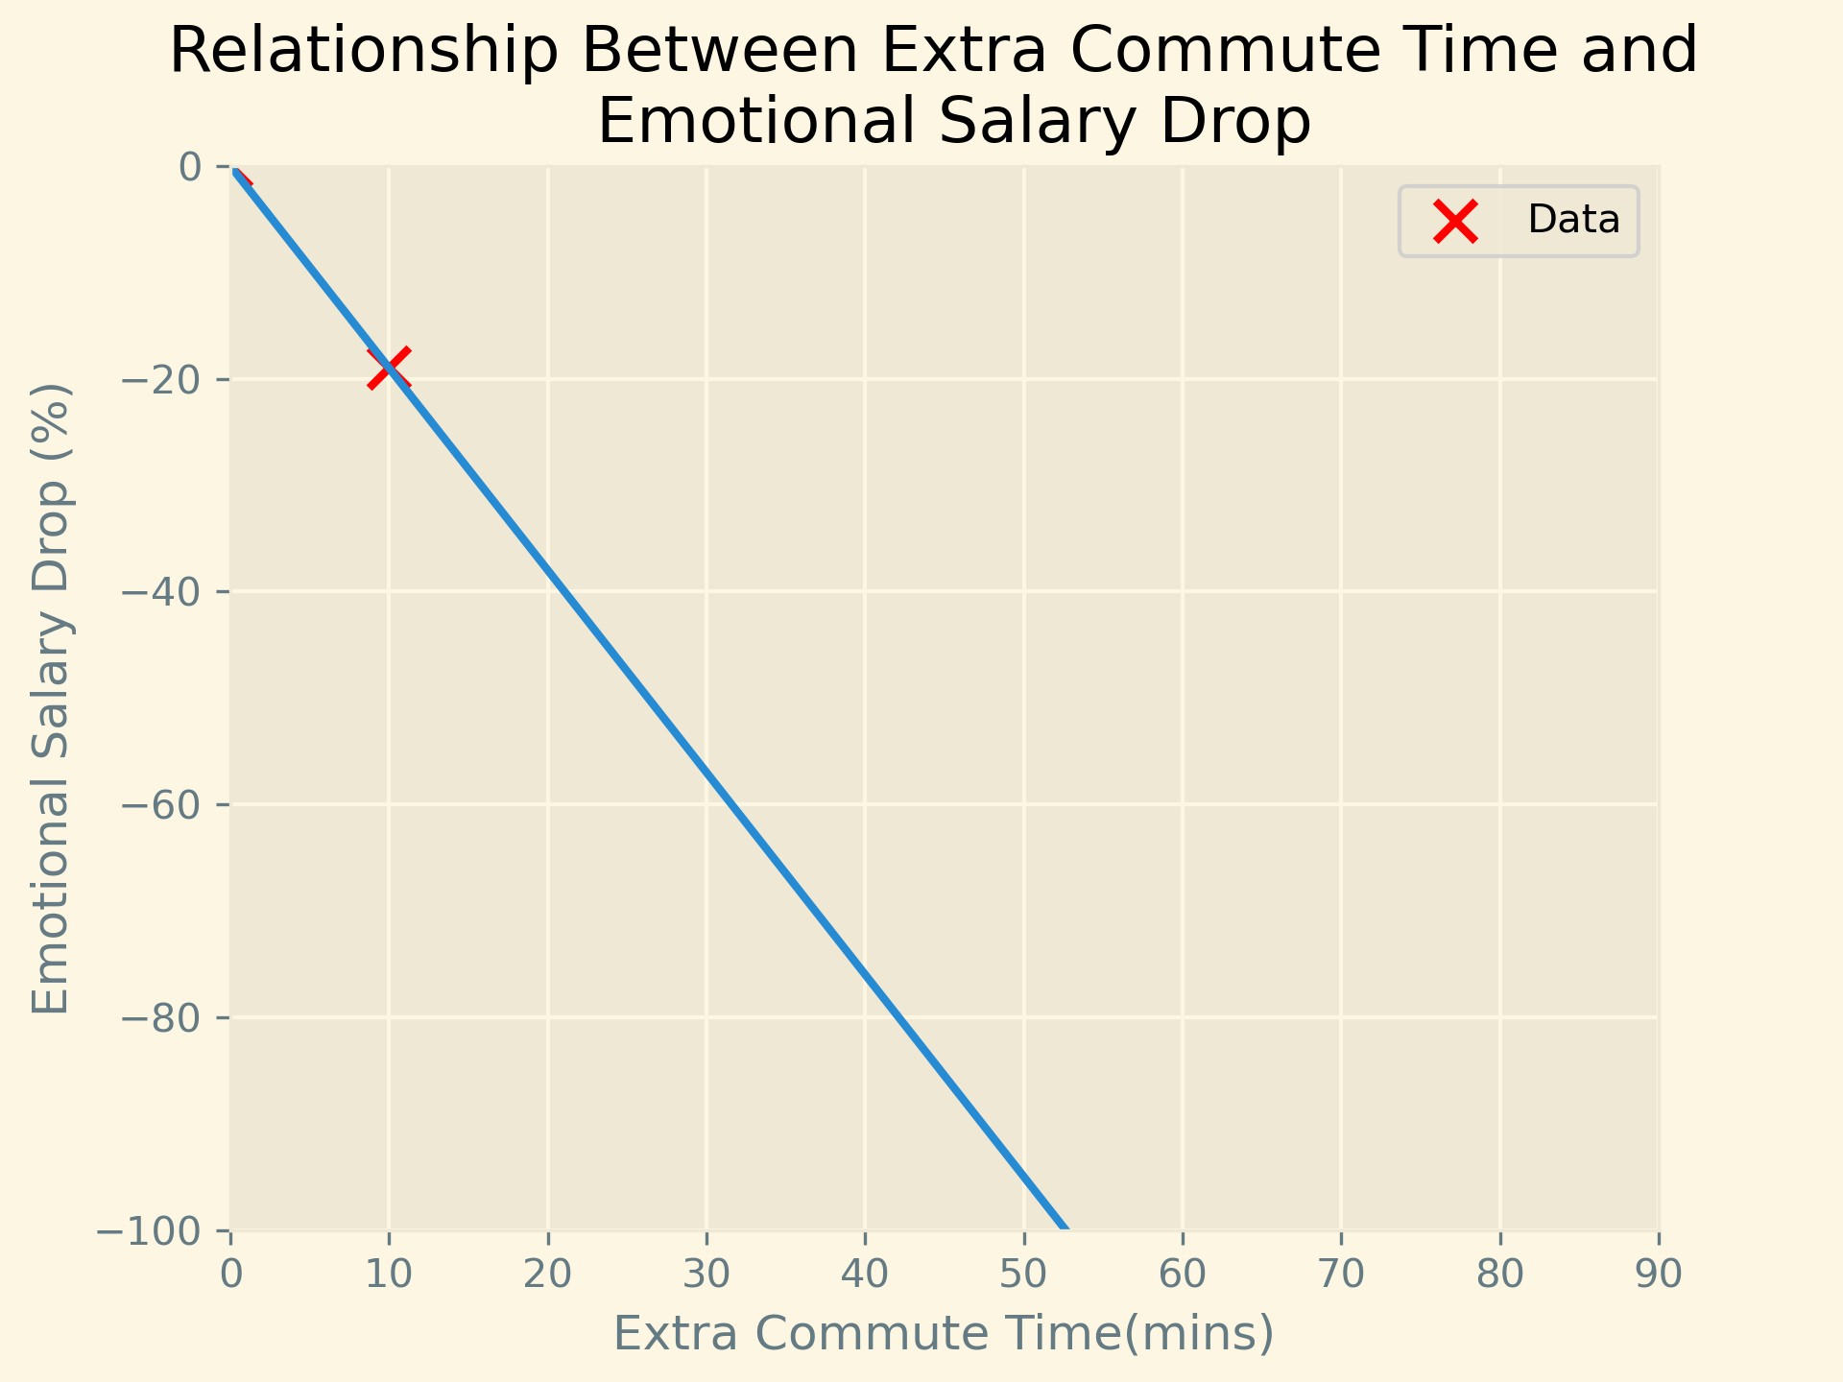
Research
Strongly negative impact on wellbeing from one extra hour of commuting time per week. (Zijlstra et al. 2020)
Higgins et al. 2017
Clark et al. 2019

Slide 12
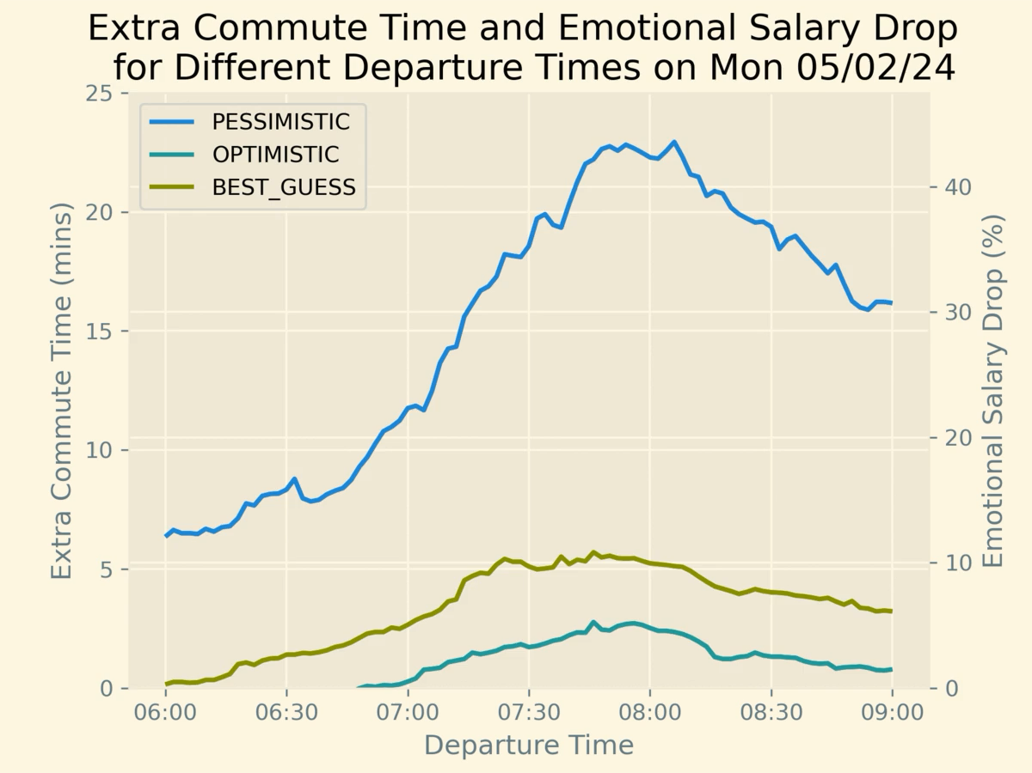
Impact on ‘emotional’ salary
Code template can be found under ‘projects’
Notes:
7:15 instead of 7:30 improves my wellbeing reducing my salary drop by 2% at minimum but at most by an average 10%

Slide 13
Extra Slides

Slide 14
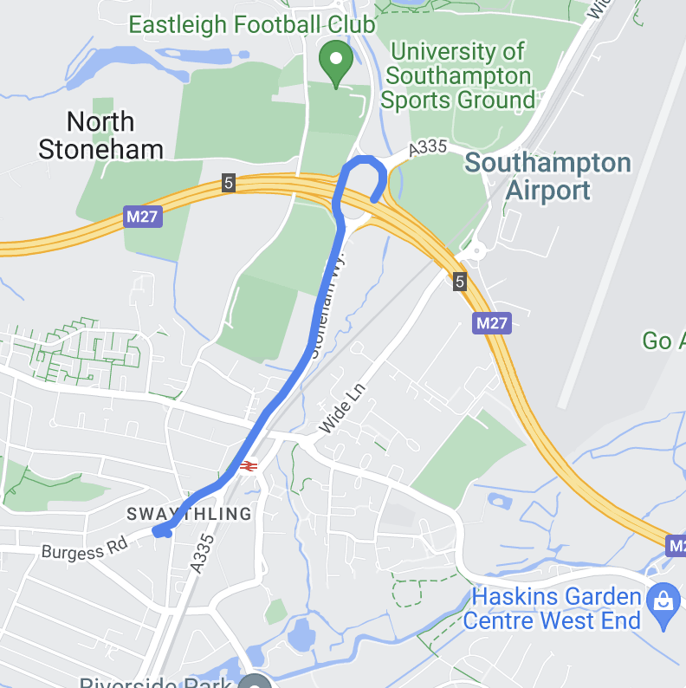
Stoneham Way

Slide 15
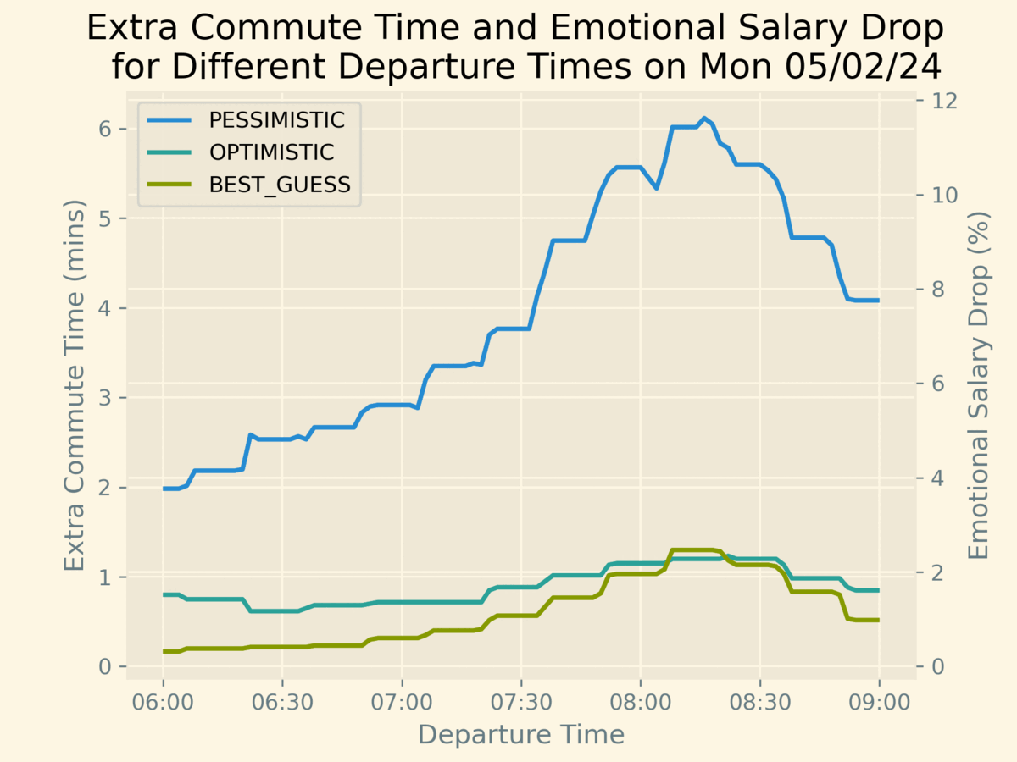
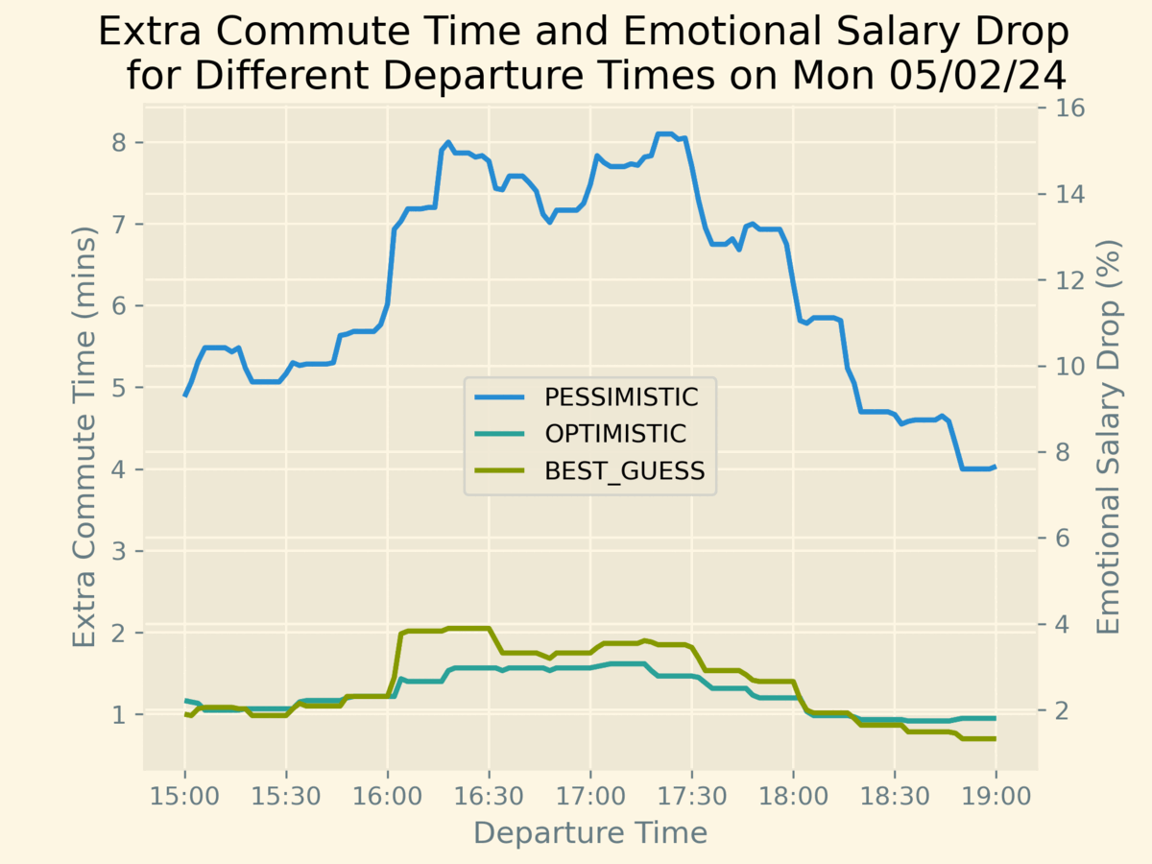
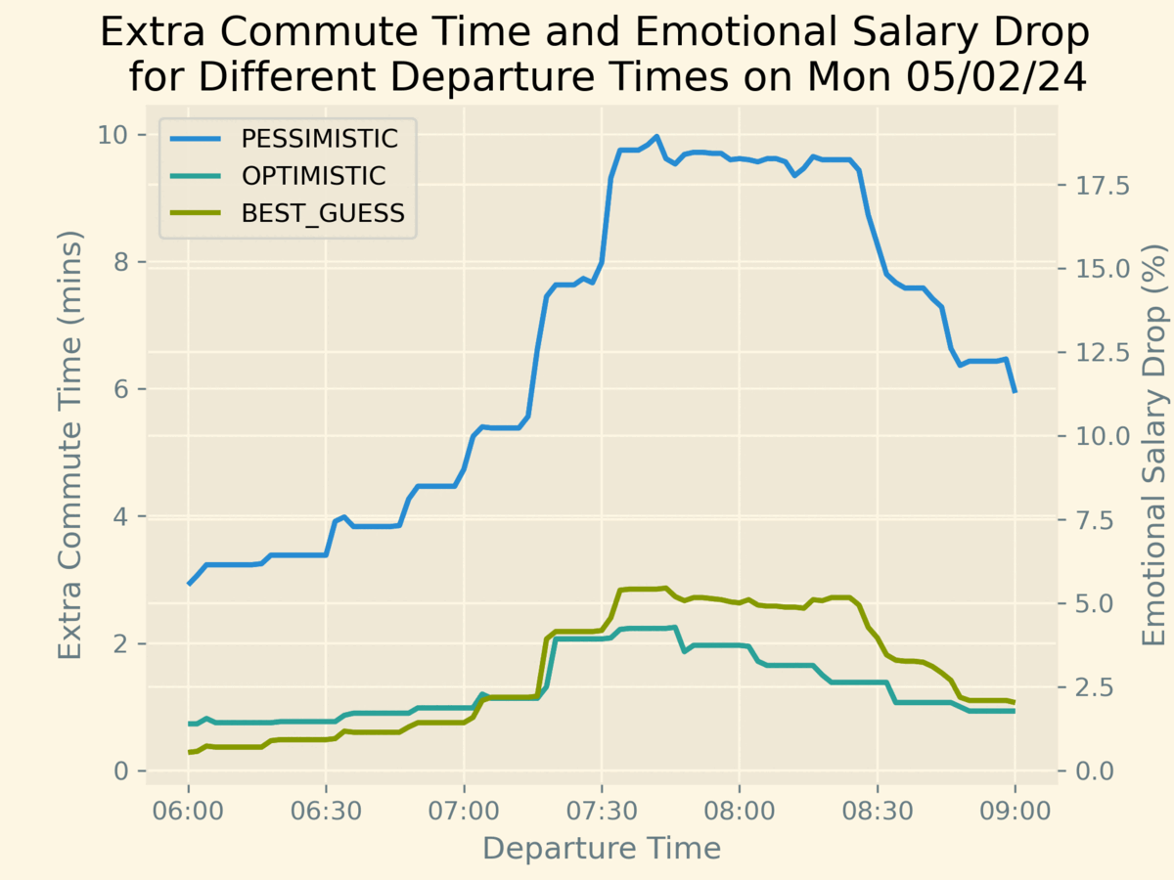
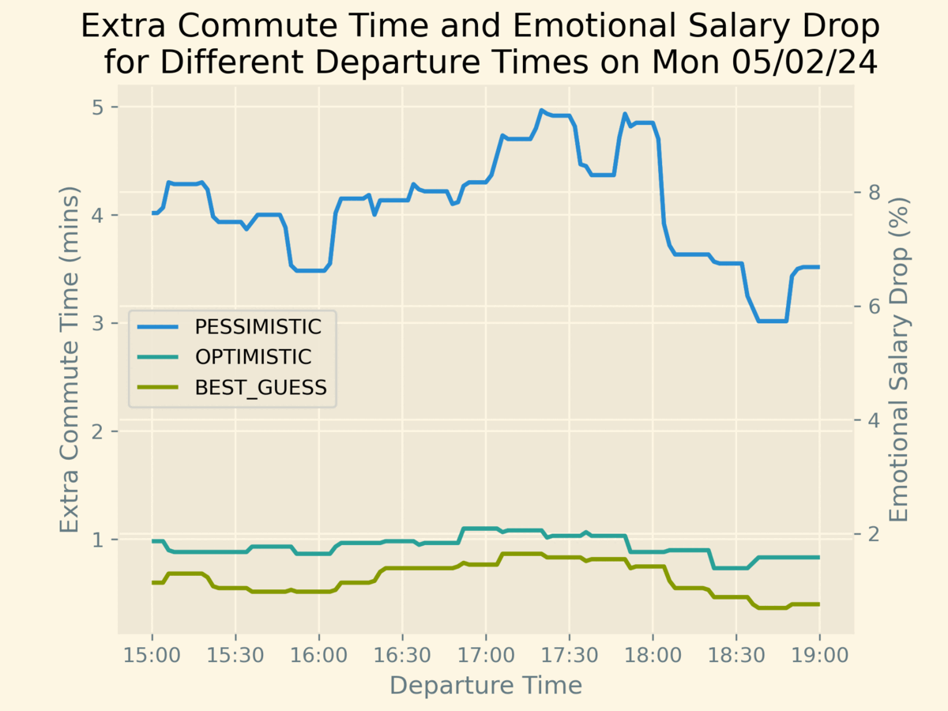
Stoneham Way
Morning into Soton
Evening Out Soton
Morning out of Soton
Evening into Soton

Slide 16
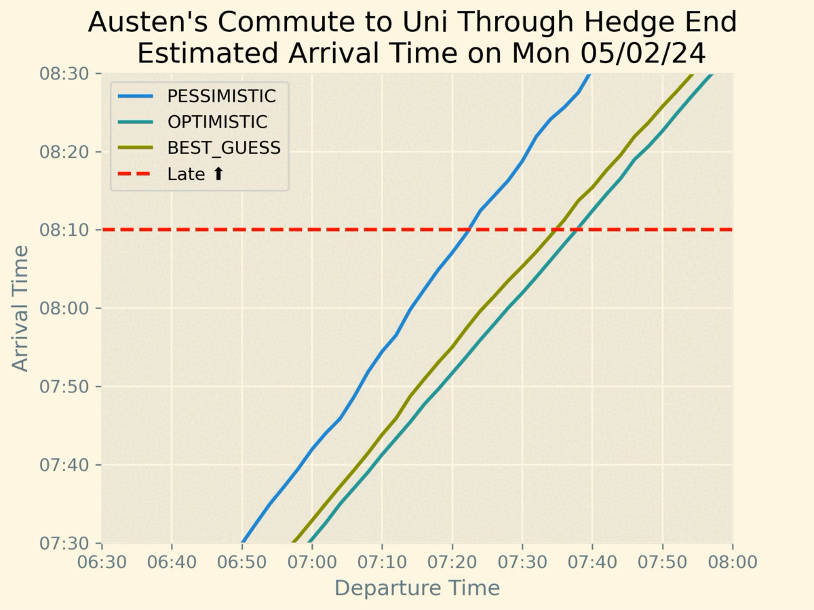
Results
Day of Week To Uni | Pessimistic Leave By | Best Guess Leave By
Monday | 07:24 | 07:36
Tuesday | 07:16 | 07:32
Wednesday | 07:16 | 07:36
Thursday | 07:22 | 07:38
Friday | 07:24 | 07:38

Slide 17
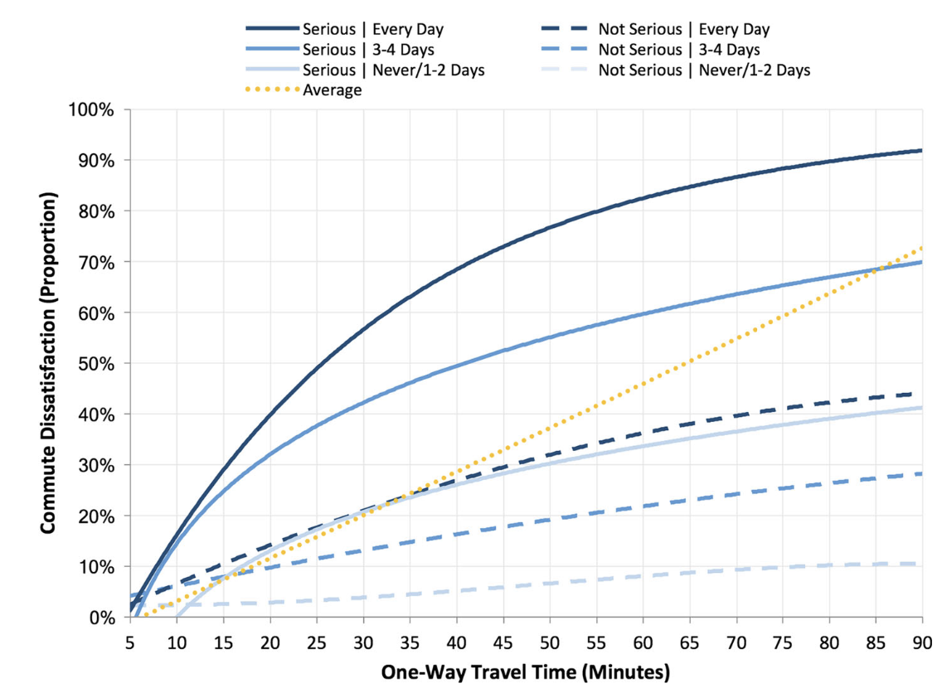
"Cruising through Soton: Optimizing Your Journey for a Satisfyingly Speedier Commute"
35 mins not-serious commute = 25% chance dissatisfied.
45 mins serious commute = 52% chance dissatisfied. (Higgins et al. 2017)
Strongly negative correlation - Impact of one extra hour of commuting time per week on wellbeing (Zijlstra et al. 2020)
a 10-min increase in commute time (one-way) is equivalent to a 19% reduction in monthly income in terms of the effect on job satisfaction (on average). (Clark et al. 2019)

